Slide 1
Advanced Computing Infrastructure for Biomedical Imaging
Dr. Shannon Quinn
Assistant Professor, University of Georgia
Departments of Computer Science and Cellular Biology
spq@uga.edu | @SpectralFilter | http://cs.uga.edu/~squinn
https://github.com/magsol/bsec-2015

Slide 2
“I have 5 million images, now what?”
What is large-scale image analysis and why do I need to know about it?
What are some available tools and methodologies?
What are some examples?

Slide 3
PART I
What is large-scale image analysis and why do I need to know about it?

Slide 4






Growth of image data
Medical imaging (Xray, fMRI)
High-throughput imaging (fluorescence, TEM)

Slide 5

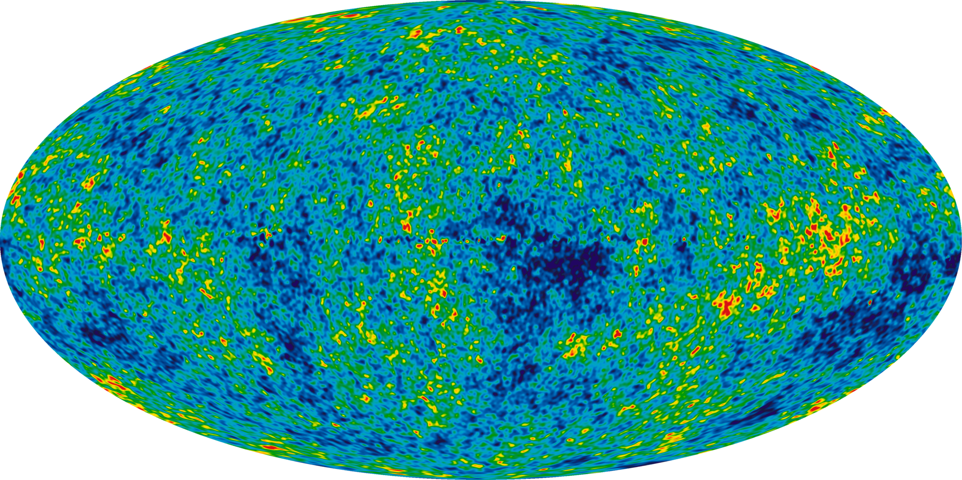
Astronomy
[1]
Sloan Digital Sky Survey
New Mexico, 2000
140TB over 10 years
Large Synoptic Survey Telescope
Chile, 2016
Will acquire 140TB every five days^{[3]}
[2]
1 http://en.wikipedia.org/wiki/Sloan_Digital_Sky_Survey#mediaviewer/File:Ilc_9yr_moll4096.png
2 http://en.wikipedia.org/wiki/File:SDSS_logo.png
3 http://www.economist.com/node/15557443

Slide 6
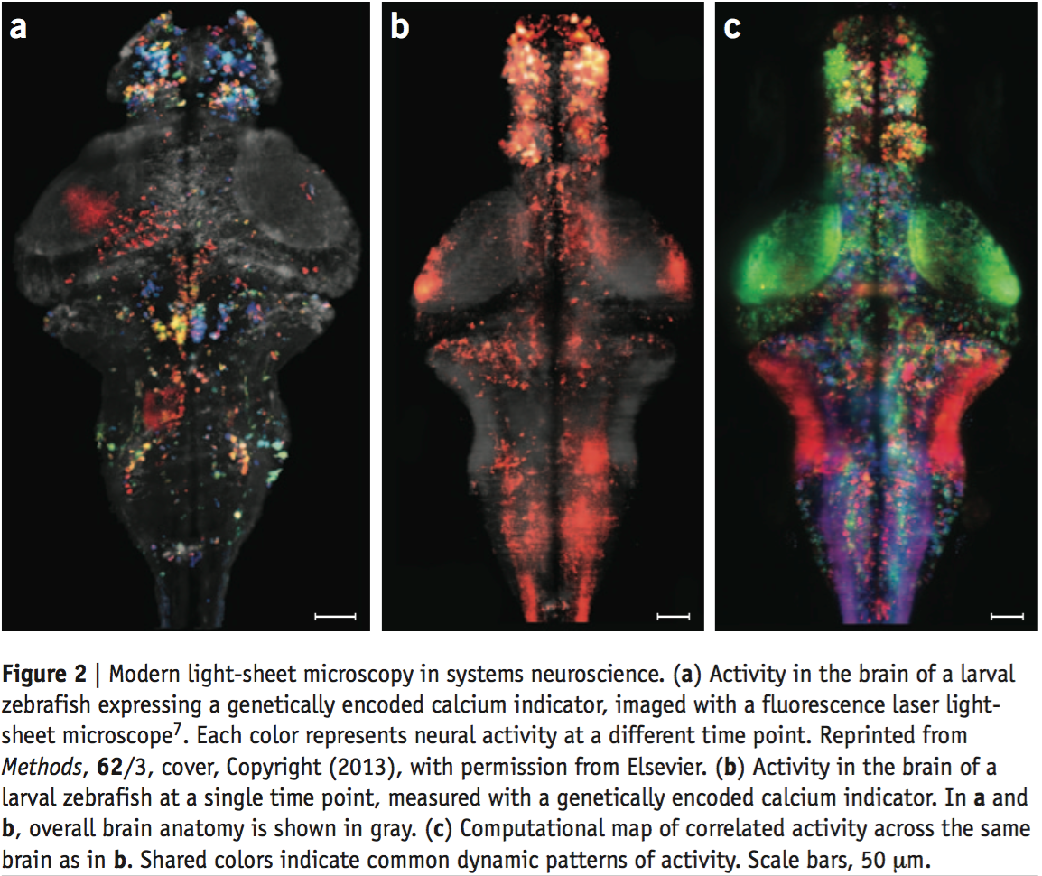
Neuroscience
^{[2]}
^{[1]}Whole-brain light-sheet imaging in larval zebrafish
1000 x 2000 x 40
2 Hz imaging rate
~1.2TB / hour
1 Current Opinion in Neurobiology 2015, 32:156–163. http://dx.doi.org/10.1016/j.conb.2015.04.002
2 Fig. 2: Nature Methods 12, 27 (2014). doi:10.1038/nmeth.3214

Slide 7




Social Networks!
Flickr
2M photos/day
Instagram
70M photos/day
Facebook
2-3TB photos/day
YouTube
300hrs video/minute

Slide 8
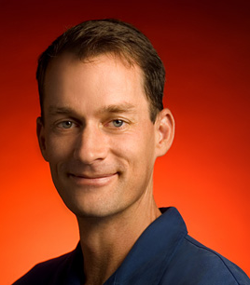
Jeff Dean
Compilers don’t warn Jeff Dean. Jeff Dean warns compilers.
Jeff Dean builds his code before committing it, but only to check for compiler and linker bugs.
Jeff Dean writes directly in binary. He then writes the source code as a documentation for other developers.
Jeff Dean once shifted a bit so hard, it ended up on another computer.
When Jeff Dean has an ergonomic evaluation, it is for the protection of his keyboard.
gcc -O4 emails your code to Jeff Dean for a rewrite.
When he heard that Jeff Dean's autobiography would be exclusive to the platform, Richard Stallman bought a Kindle.
Jeff Dean puts his pants on one leg at a time, but if he had more legs, you’d realize the algorithm is actually only O(log n)

Slide 9
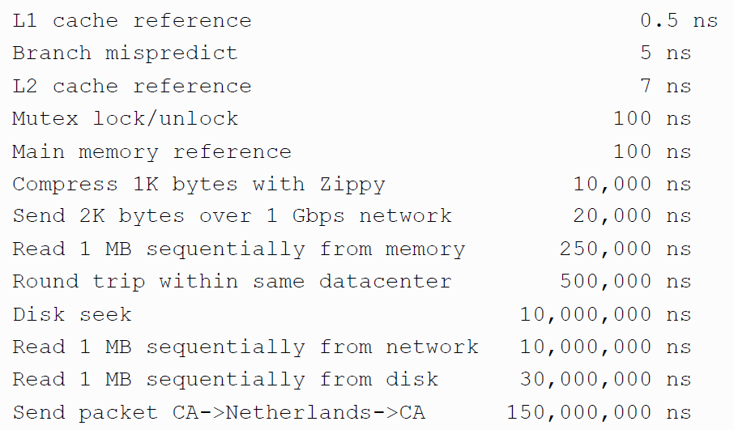
Numbers (Jeff Dean says) Everyone Should Know
~= 10x
~= 150x
~= 100,000x

Slide 10
Big Data 101
Distributing data in memory across machines is not as cheap as accessing memory locally because of communication costs.
The problem we’re dealing with is not size. It’s the interaction between size and locality: we have a large structure that’s being accessed in a non-local way.

Slide 11
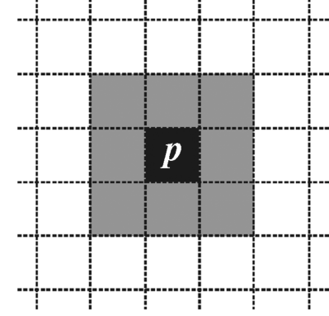
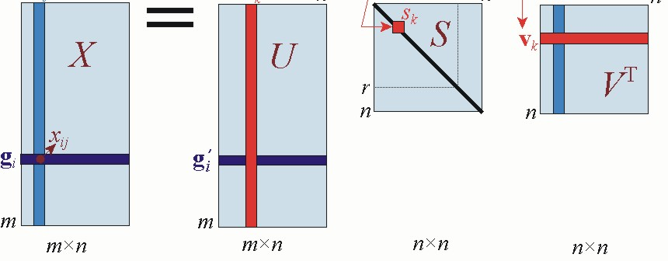
Big Imaging 101
Non-locality is huge
Seeded watershed
Optical flow
Wavelets
Raster scan
Singular value decomposition
[etc]
Random/array access is out; need alternatives

Slide 12
PART II
What are some available tools and methodologies?

Slide 13
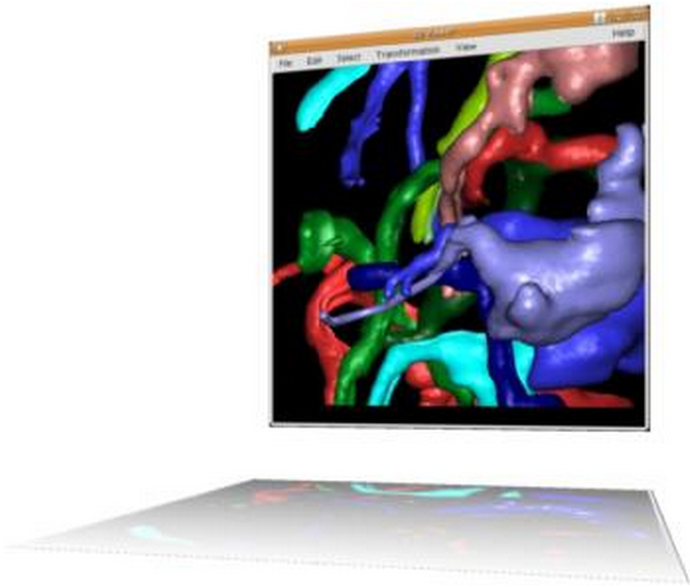
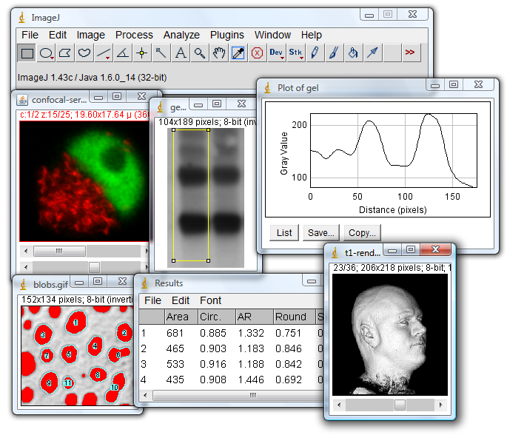
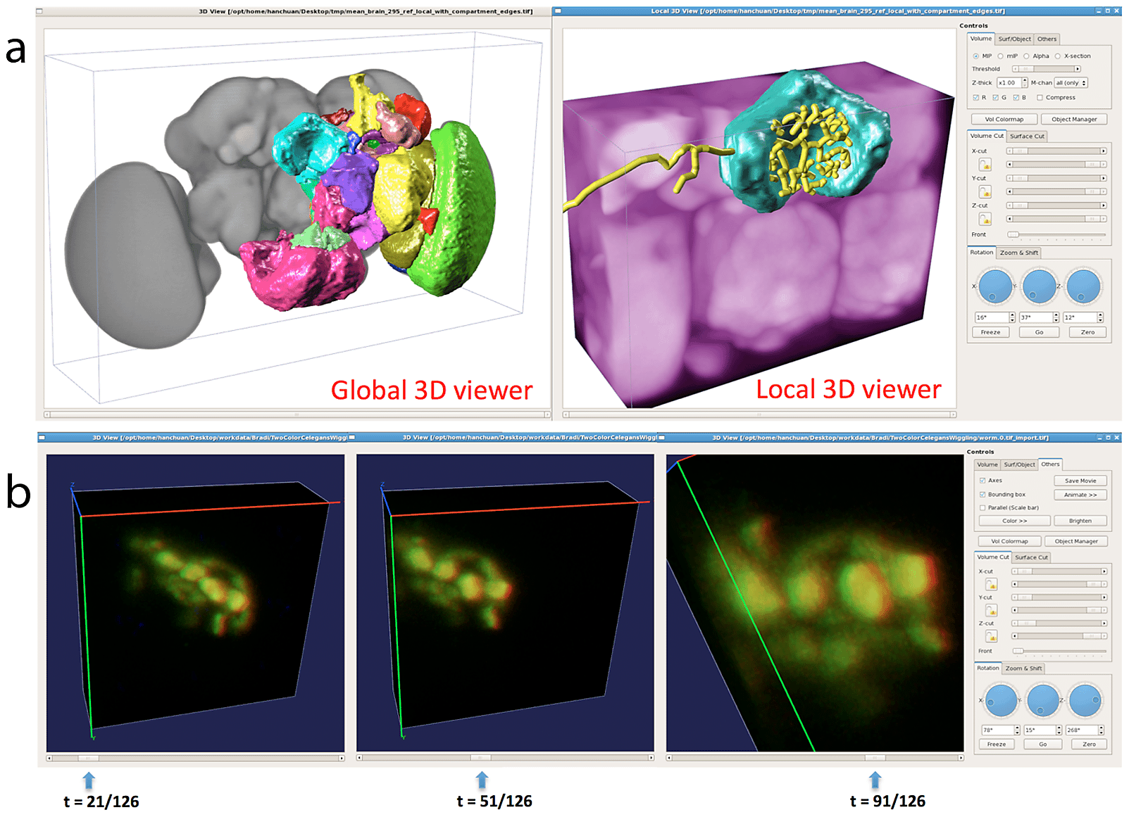
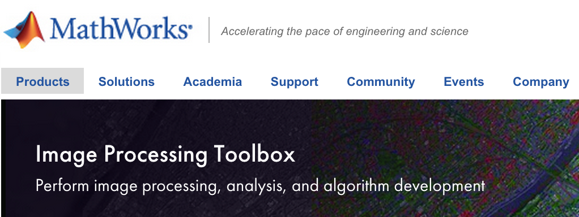
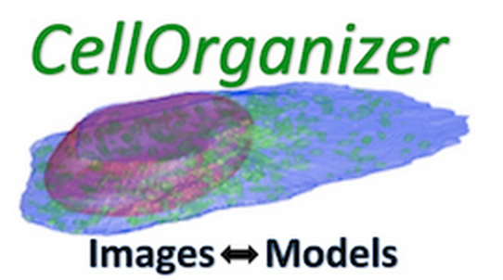
“Traditional” imaging tools
ImageJ
Fiji
Vaa3D
CellOrganizer
Matlab
[Other]
???

Slide 14
Tools for big imaging
Runs outside a “traditional” workstation environment

Slide 15
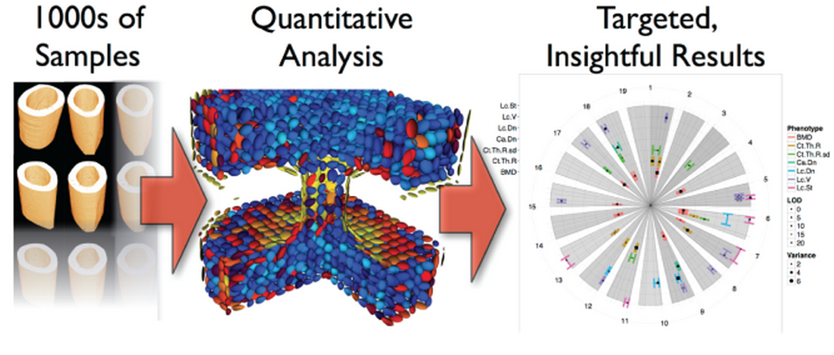
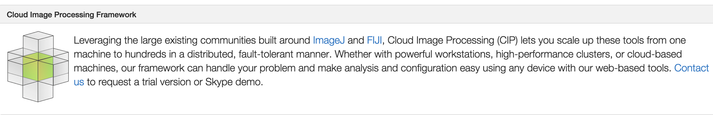
4Quant
Spin-off company from ETH Zurich and the Paul Scherrer Institut
Built on Apache Spark

Slide 16

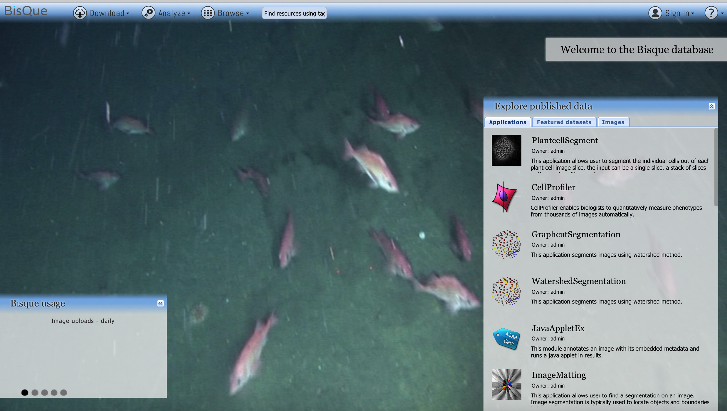
BisQue
Cloud-based biomedical image analysis toolbox
Open source

Slide 17
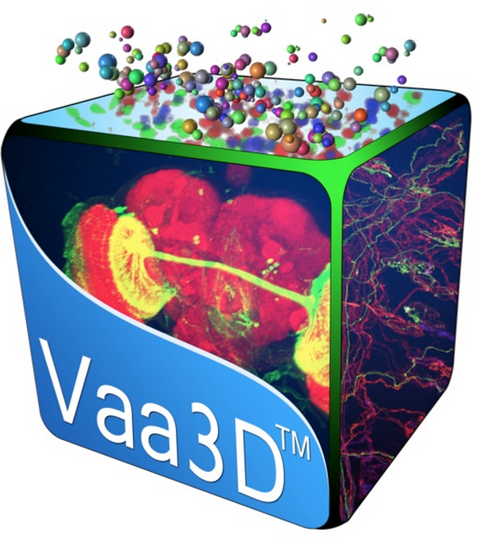

Vaa3D
3D Visualization-assisted analysis
Open source
Actively developed
BigNeuron project

Slide 18
Big imaging methodologies
Common engine
Current solutions are often highly tailored to a very narrow use-case (i.e., MPI)
Scalable
We purchased another node; do we need to reconfigure the cluster and rebuild the source from scratch?
Standardized data format
Most of “compute time” is spent putting data in an operable format

Slide 19
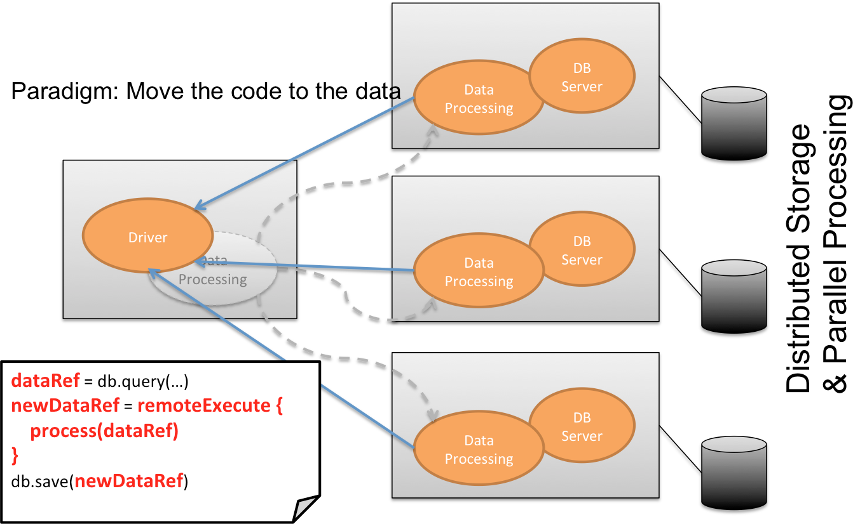
1: Storage paradigms
Exploit non-locality

Slide 20
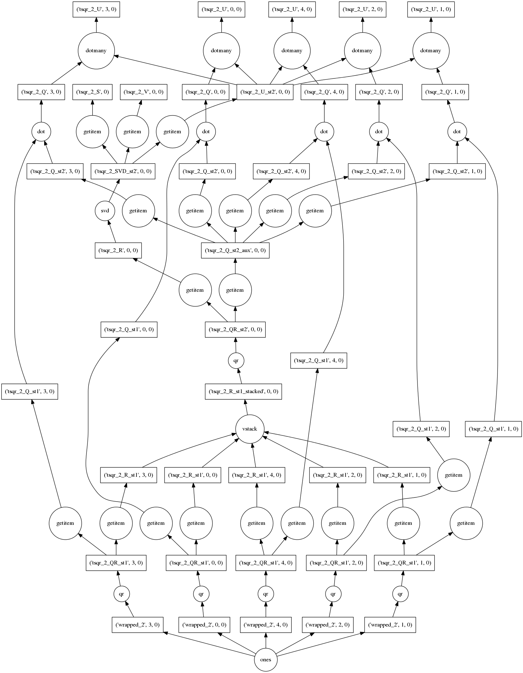
2: Scheduling paradigms
“Lazy” evaluation
On-the-fly workflow optimization
Decouple APIs from execution

Slide 21
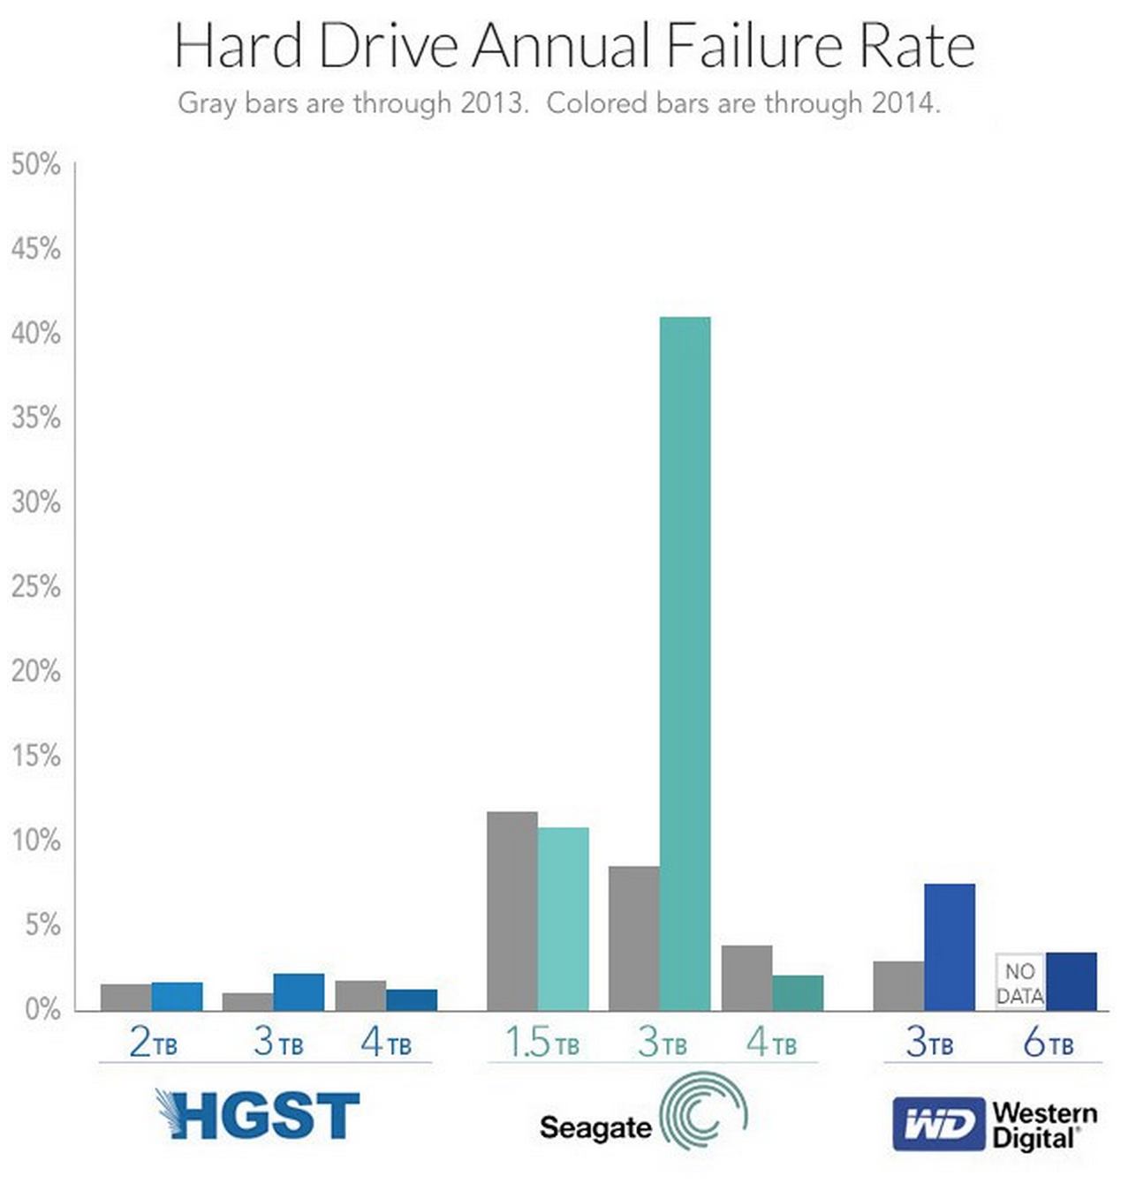
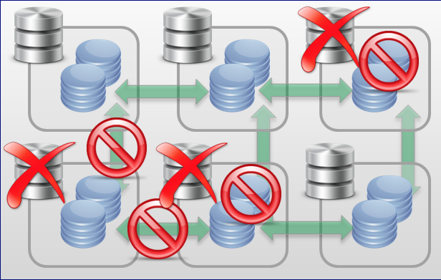
3: Redundancy paradigms
Hardware will fail
2013-2014 hard disk failure rates, by vendor
Built-in redundancy
http://www.extremetech.com/computing/198154-2014-hard-drive-failure-rates-point-to-clear-winners-and-losers-but-is-the-data-good

Slide 22
The Punchline: Why “big bioimaging” is hard
The REAL Punchline
These principles apply to *all* areas of “big data.”
What we’re used to
What we need
Use ImageJ to load up a handful of images
Click “watershed” and immediately view results
Store dataset on a RAID
Intuitive UI for specifying analytics and visualizing results (Vaa3D, BisQue)
Under-the-hood scheduling built for a variety of use-cases (Spark, Flink)
Distributed filesystem or cloud storage (Amazon S3, HDFS)

Slide 23
PART III
Examples

Slide 24
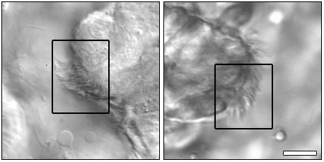
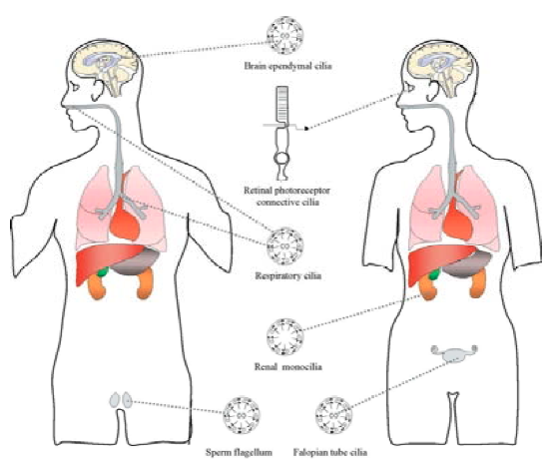
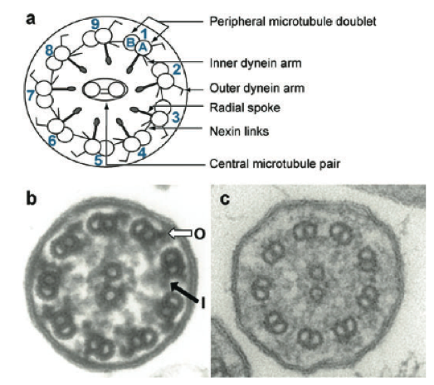
Example 1: Ciliary motion
1
3
2
Scale bars: 10μm
¹Data: Dr Cecilia Lo’s lab
²http://www.hitech-projects.com/euprojects/artic/index/Cilia%20in%20nature.pdf
³Zariwala et al. "Genetic defects in ciliary structure and function." Annu. Rev. Physiol. 69 (2007): 423-450.

Slide 25
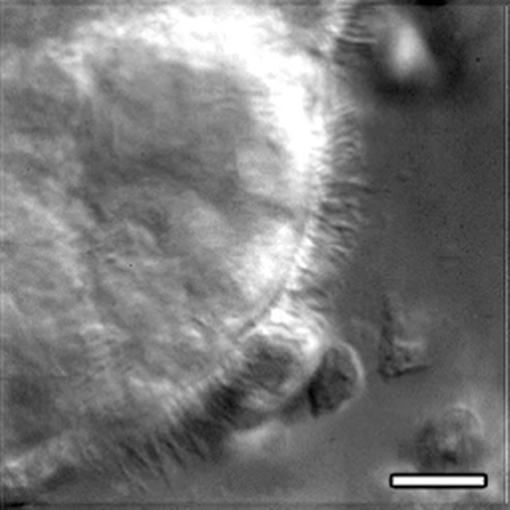
Significance
Clinical
Ciliopathies
Association with congenital heart disease
Developmental
Nodal flow
Left-right asymmetry

Slide 26
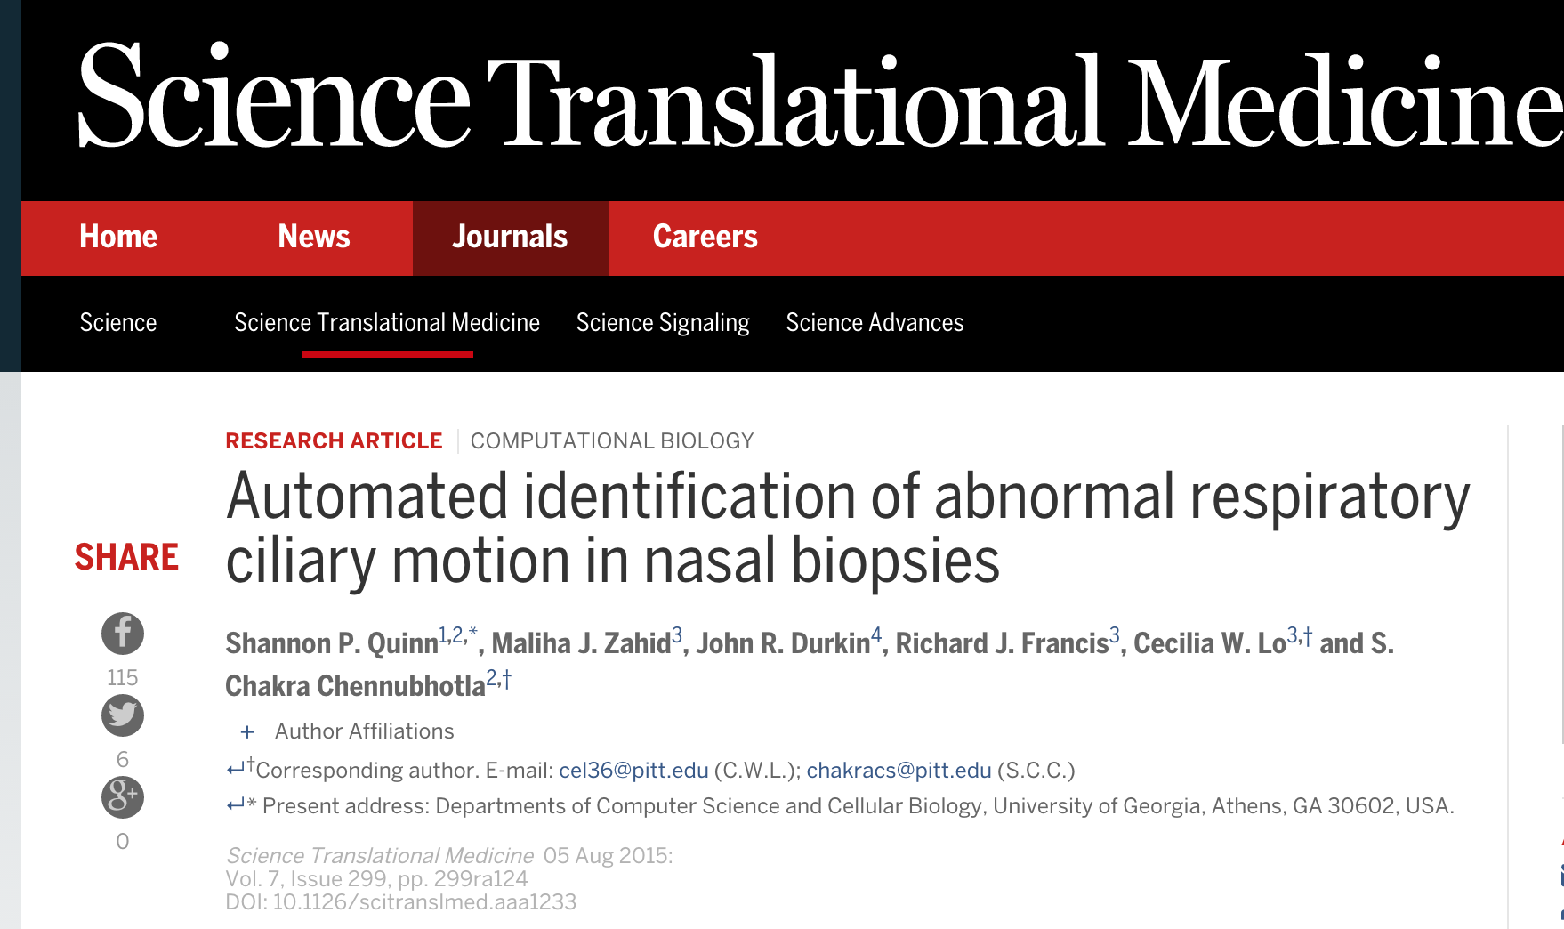
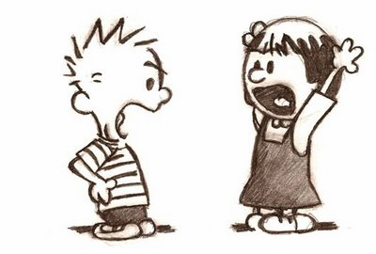

Automated ciliary motion recognition
Input: high-speed video of ciliary biopsy
Output: quantitative properties of observed motion
WAVY!
7.4
Curly!

Slide 27
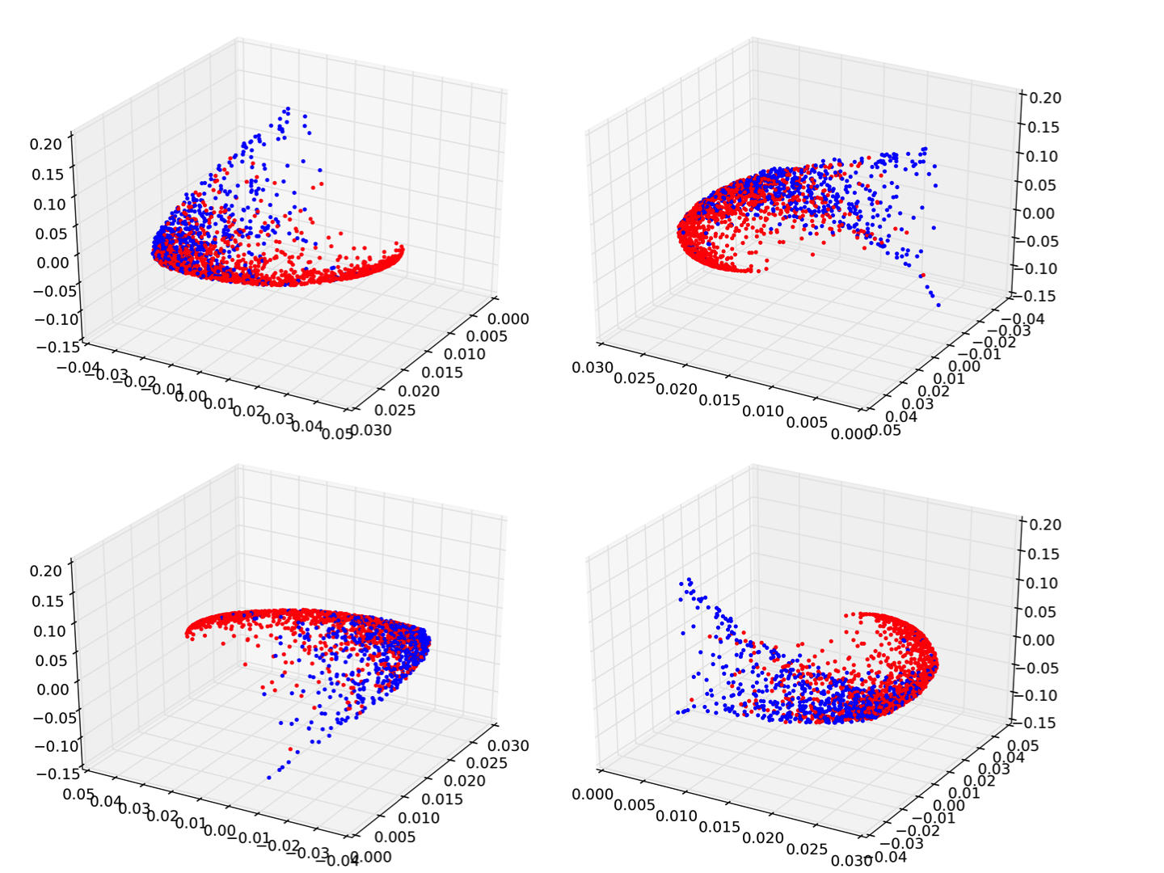
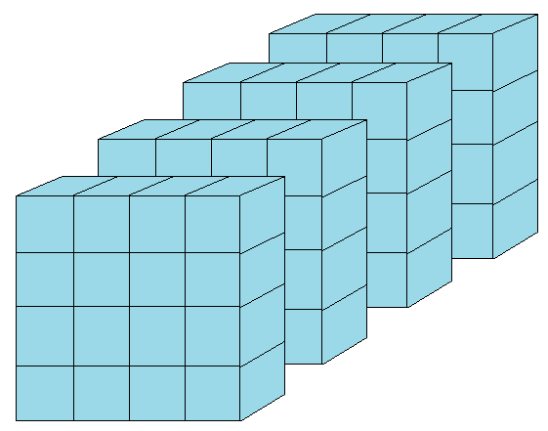
Cilia videomicroscopy data
> 400 patients
10 videos per patient
5 regions of interest per video
= 20,000 high-dimensional data points

Slide 28
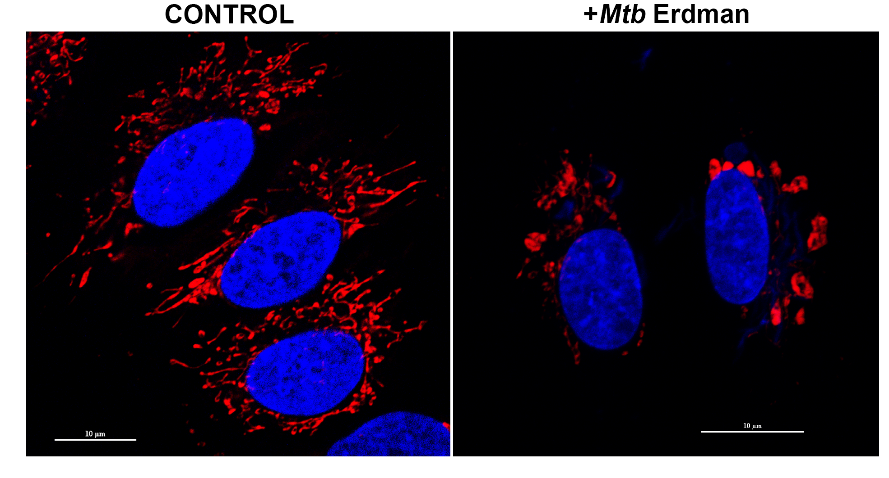
Example 2: Organellar evolution
Mycobacterium tuberculosis
Induces cell necrosis
Mitochondrial degradation

Slide 29
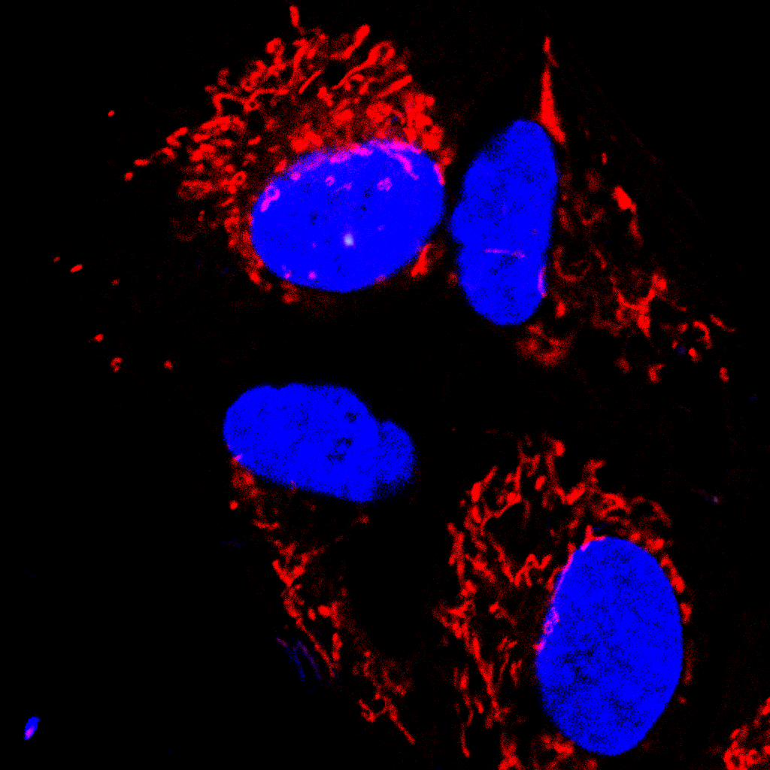

High-throughput screening
4400 genes in Mtb to screen
Other genotype-phenotype associations
listeria
shigella
legionella
…?
General framework: OrNet
Division of Biological Infrastructure

Slide 30
24hrs uninfected
24hrs infected

Slide 31
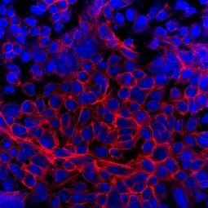
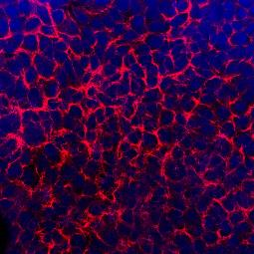
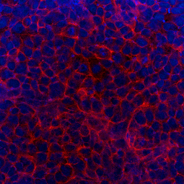
6 hours uninfected
6 hours infected
24 hours uninfected
24 hours infected

Slide 32
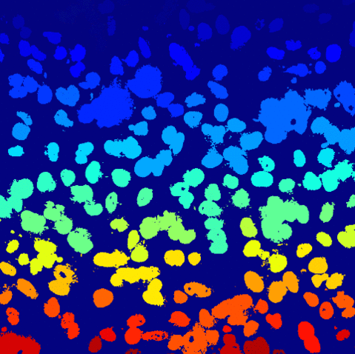
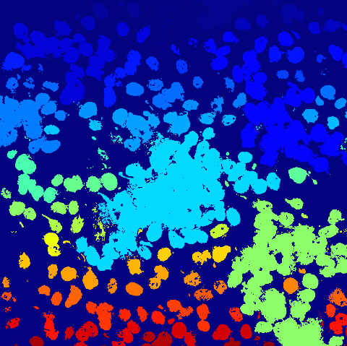
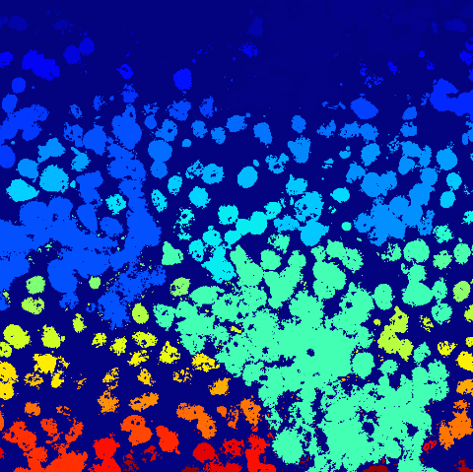
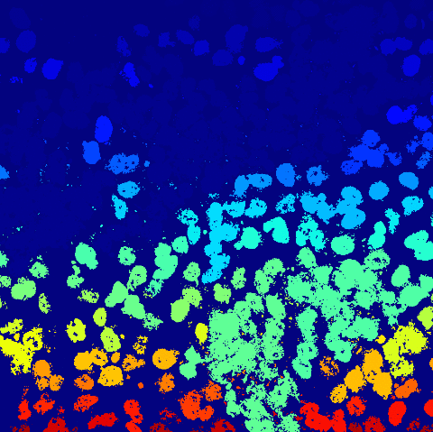
6 hours uninfected
6 hours infected
24 hours uninfected
24 hours infected

Slide 33

Example 3: Demo!
https://github.com/magsol/bsec-2015

Slide 34
In summary…
Software is changing
Fault-tolerance
Greater abstraction
Assumptions are changing
API != Workflow
Tools with the best of both worlds: scalable + immediate
“This isn’t your parents’ bioimaging.”

Slide 35
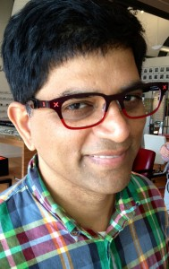
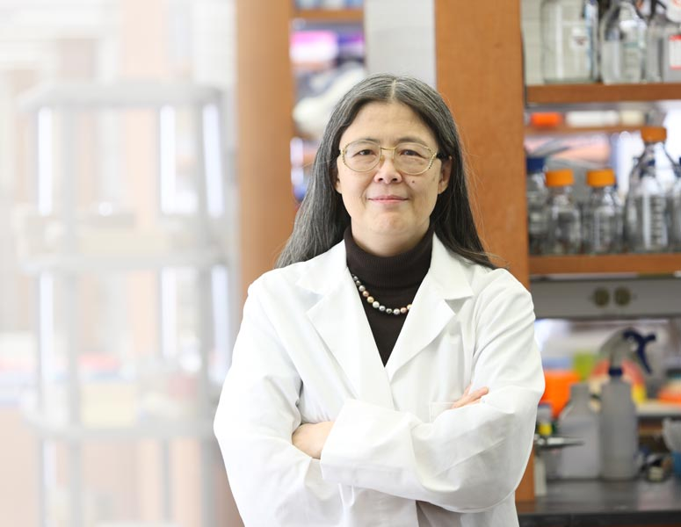
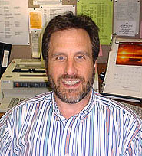
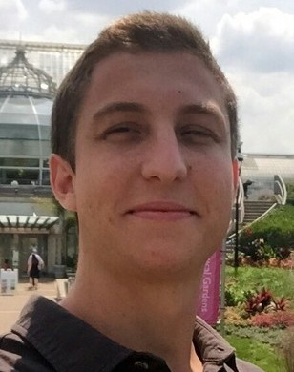
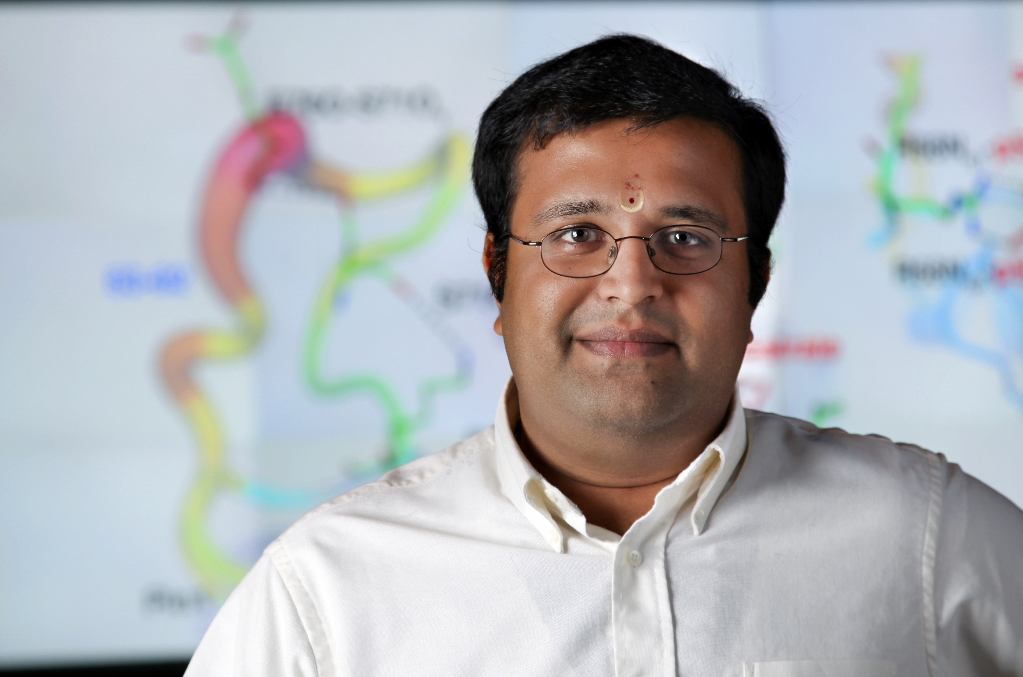
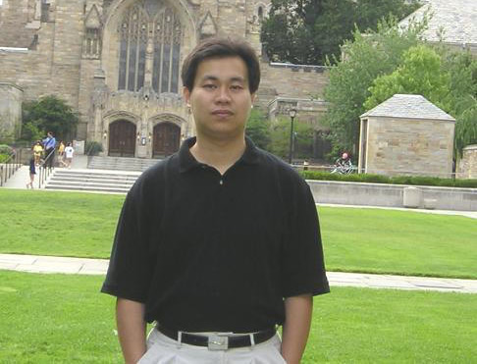



Acknowledgements
Dr. Pramod Giri
Dr. James Barber
Chinasa Okolo
Manish Ranjan
BahaaEddin AlAila
Ankita Joshi
Alekhya Chennupati

Slide 36

Thank you!
Slides and IPython notebook available at:
https://github.com/magsol/bsec-2015

